Slide 1


Block_IP Security Automation Dashboard
Automated Threat Intelligence & IP Blocking
Technical Presentation / 針對 IT 團隊技術簡報

Slide 2


Introduction / 專案簡介
Project Purpose (目的)
Automate the analysis of SSLVPN failed logins from FortiAnalyzer (FAZ) and correlate them with VirusTotal's threat intelligence to identify and block malicious attackers.
自動分析 FAZ 上的 SSLVPN 登入失敗日誌，並結合 VirusTotal 的威脅情資來識別並阻擋惡意攻擊者。
Key Components (核心組件)
Python Backend: API Integration & Data Processing
SQLite Database: Local Caching & Data Aggregation
PHP/JS Dashboard: Real-time Data Visualization

Slide 3









Analysis Workflow / 分析流程架構
1. Data Extraction
2. Threat Intel & Cache
3. Dashboard & Verdict
Fetch raw logs via JSON-RPC. Filter private IPs, extract target public IPs from FAZ.
Check local SQLite Cache first to save quota. If miss, query VirusTotal API v3.
Classify based on vendor flags (Malicious, Suspicious, Clean). Display instantly.

Slide 4

Querying FAZ Logs / 透過 API 查詢 FAZ
Protocol & Auth
Asynchronous Process
Robust and secure connection methodologies to ensure data integrity and confidentiality without exposing credentials.
Handling large log datasets requires an async approach to prevent timeouts and ensure complete data retrieval.
Protocol: Fortinet JSON-RPC 2.0 API
Send search query (e.g., subtype == vpn && action == ssl-login-fail).
Authentication: Bearer Token
FAZ backend returns a unique Task ID (tid).
Security: No passwords stored in scripts
Python continuously polls FAZ for chunks of logs using the tid until 100% complete.
Endpoint: /logview/adom/root/logsearch

Slide 5

VirusTotal API Integration
Our REST API v3 integration aggressively handles rate limit throttles (HTTP 429) via automated time.sleep() pauses.
To preserve free API quotas, we deployed a 3-Tier Cache System:
•
Permanent Blacklist (30-day TTL)
•
General Cache (7-day TTL)
•
Live API Fetch
Result: Saves >90% of API calls.

Slide 6


Technical Limitations & Solutions
75K
4/MIN
FAZ API Log Ceiling FAZ protects memory by hard-capping single queries. Solution: Windows Task Scheduler cron jobs fetch small hourly deltas, permanently bypassing the ceiling.
VirusTotal Free API Throttle Free tier strictly limits request velocity. Solution: Aggressive SQLite caching mitigates this, though bulk initial scans may take minutes to clear.

Slide 7









Next Steps & Scaling Out / 擴展建議
Single Pane of Glass
Required Logic Changes
Auto-Blocking Goal
Because FAZ centralizes logs for all infrastructure, scaling to a 2nd, 3rd, or 10th FortiGate requires zero direct firewall queries.
The ultimate milestone: Push the generated Malicious IPs list back to FortiGates via Fortinet Fabric Connectors (External Dynamic Block List).
Update FAZ search filters to group by devid (Device ID). Add a source_device column to the SQLite cache schema and PHP UI dropdowns.

Slide 8

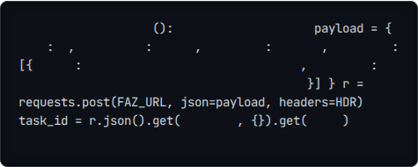
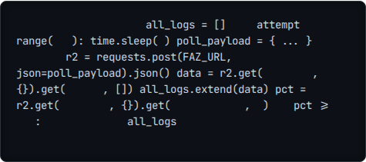
Appendix A: Querying FAZ API
1. Start the Search Task
2. Continually Poll for Results
def
search_faz_logs
# Init search task
# Poll using Task ID
for
in
"id"
1
"jsonrpc"
"2.0"
"method"
"exec"
# use task_id
100
2
"params"
"url"
"/logview/adom/root/logsearch"
"filter"
"subtype==vpn && action==ssl-login-fail"
"result"
"data"
'result'
"result"
"percentage"
0
if
'tid'
100
break
return

Slide 9


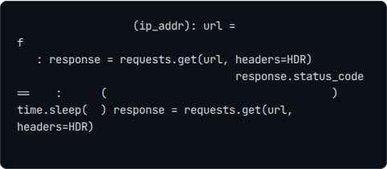
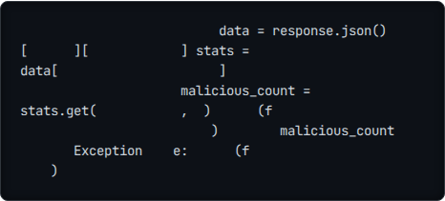
Appendix B: Querying VT API
1. Handle Rate Limiting
2. Extract Malicious Flags
def
classify_ip_vt
# Parse the JSON response
"https://virustotal.com/api/v3/ip_addresses/{ip_addr}"
'data'
'attributes'
try
# Handle Free Tier Throttle (4 per min)
# Count vendor flags marking as malicious
'last_analysis_stats'
if
429
print
"[Warning] Rate limit. Wait 60s..."
"IP: {ip_addr} | Flags: {malicious_count}"
'malicious'
0
print
60
return
except
"Error querying VT: {e}"
as
print
return None

Slide 10
Questions?
Thank you for your time and attention.
IT Department | Cybersecurity Team

Slide 11





Image Sources
https://png.pngtree.com/thumb_back/fw800/background/20251210/pngtree-futuristic-isometric-illustration-of-a-computer-system-with-glowing-internal-components-image_20794218.webp
Source: pngtree.com
https://www.hts-italy.com/wp-content/uploads/2023/10/Log_Parsing-1200x500-c-default.png
Source: www.hts-italy.com
https://image.shutterstock.com/image-vector/neon-glowing-data-server-icon-250nw-2676899557.jpg
Source: freesvg.org
https://img.freepik.com/premium-photo/hacker-with-abstract-big-data-interface-blurry-background-software-hacking-concept-double-exposure_670147-57346.jpg
Source: www.freepik.com
https://static.vecteezy.com/system/resources/previews/015/649/112/non_2x/abstract-background-digital-concept-cybersecurity-shield-anti-virus-malware-spy-protection-cyber-theft-security-on-a-blue-black-background-vector.jpg
Source: www.vecteezy.com

